Slide 1
Deep Neural Networks for News Recommendations
Hunter clearY

Slide 2
System of Neural Networks
The system presented contains 3 neural networks designed to analyze news articles and a user’s preference towards them.
Two of the networks in the system are recurrent neural networks, while the third is a convolutional neural network.

Slide 3
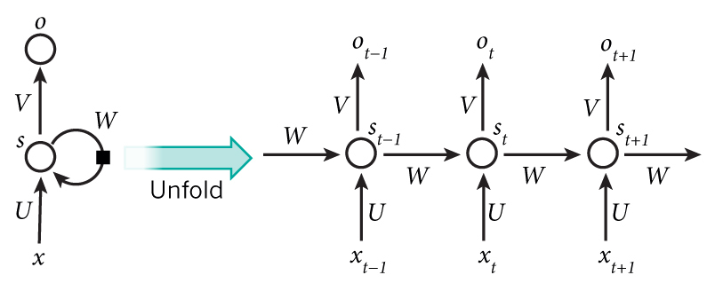
Purpose of Recurrent Networks
The two recurrent networks analyze the user’s previous history to make educated predictions on what else may be interesting.
The first processes views from the current session, while second uses long term history from the user.

Slide 4
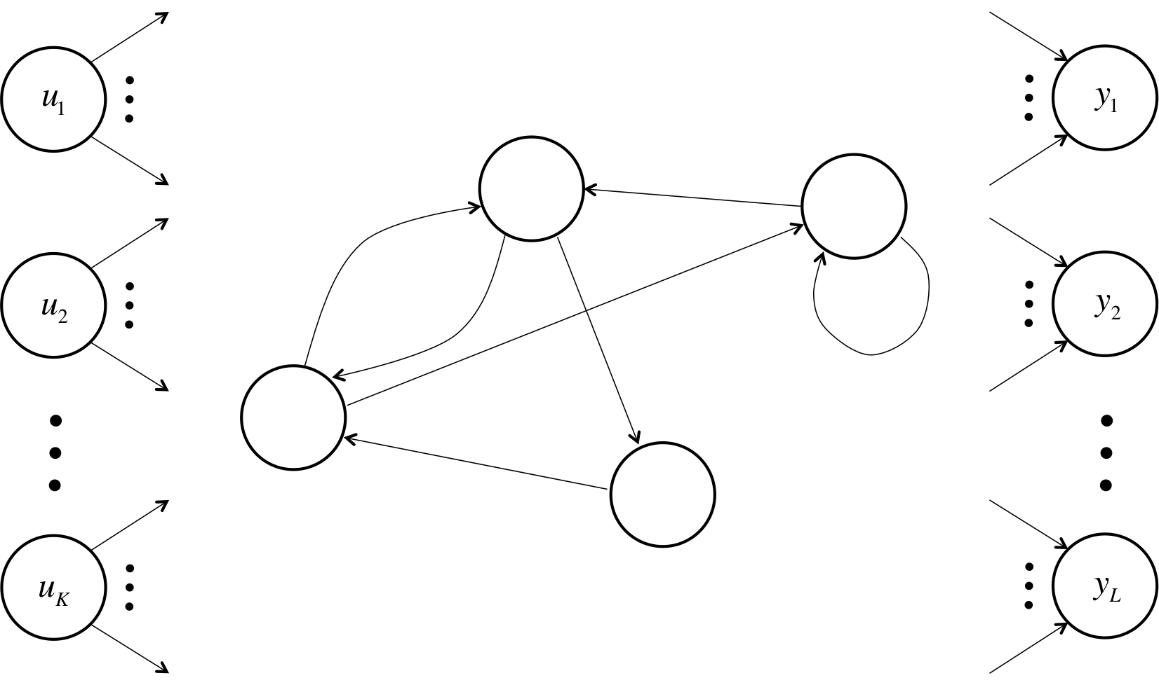
Function of Recurrent Networks
Recurrent neural networks are designed to make use of information that comes in sequences.
Commonly used in natural language natural processing (Predictive Text)
Consists of input, output, and hidden units. As states change, the functions of hidden units receive data and alter themselves in order to come closer to the desired output.

Slide 5
Purpose and Function of Convolutional Networks
Convolutional neural networks go through data with filters in order to recognize patterns.
After being given a training dataset, functions are performed an output probabilities are calculated. Total error is calculated based on the training dataset. Data is then weighted and categorized based on these percentages.
In the case of some news sites, not all articles are properly categorized. The convolutional network is implemented to set these categories.

Slide 6
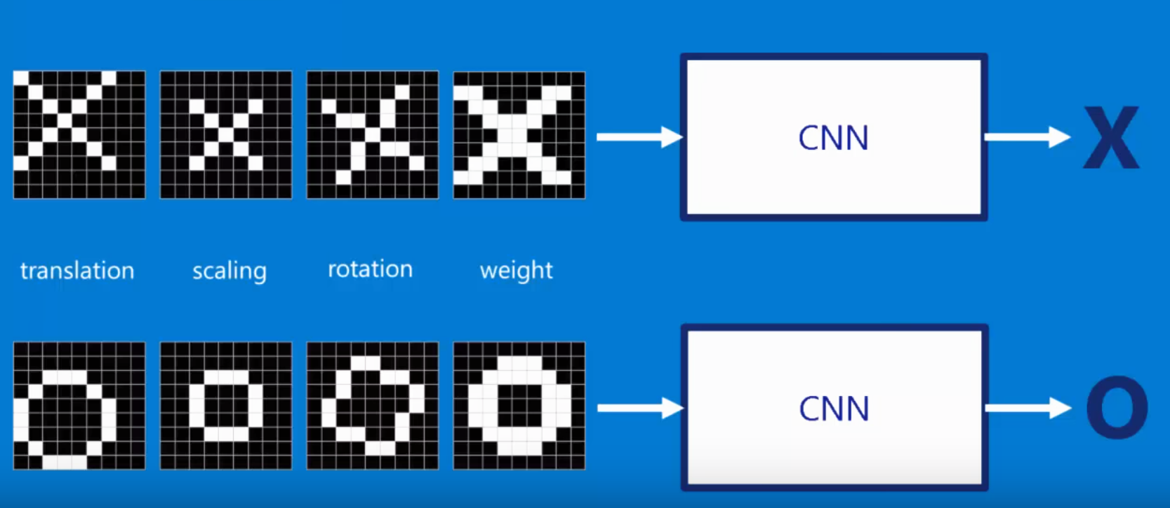
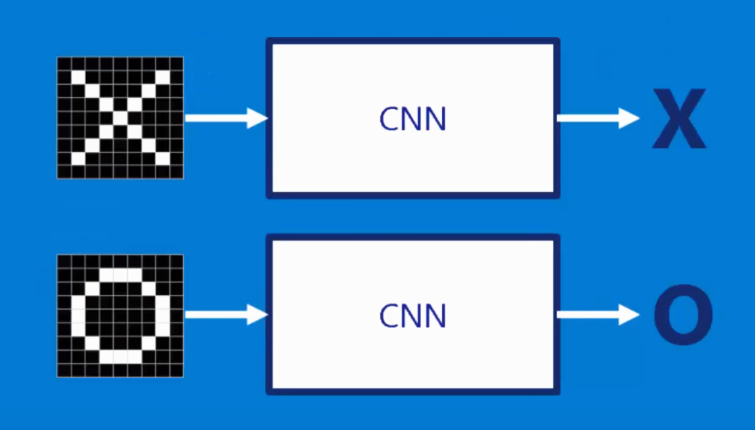

Recognizable Use

Slide 7
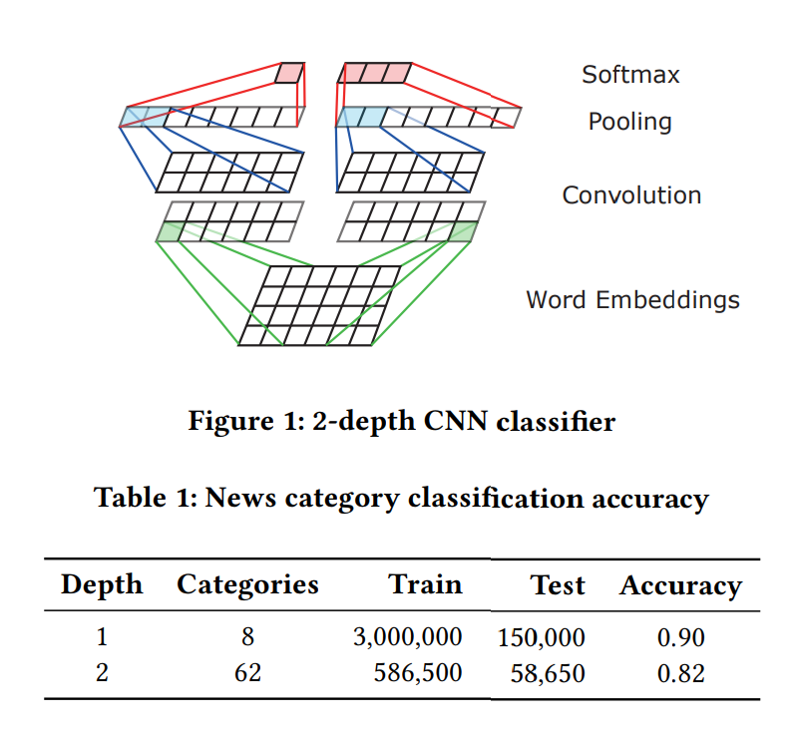
Positive Results
After a trial run, the networks were shown to be extremely beneficial.
Views increased as compared to the original system, and category classification from the convolutional network had an accuracy upwards of 80%.

Slide 8
Impact
Systems similar to the one presented have a broad range of uses amongst online services.
Click-through rates and user retention time can be increased on sites displaying media and text content.
Online retailers that use these systems can increase their sales by recommending ideal products.
Increase overall profitability and effectiveness of web traffic and views.

